Slide 1
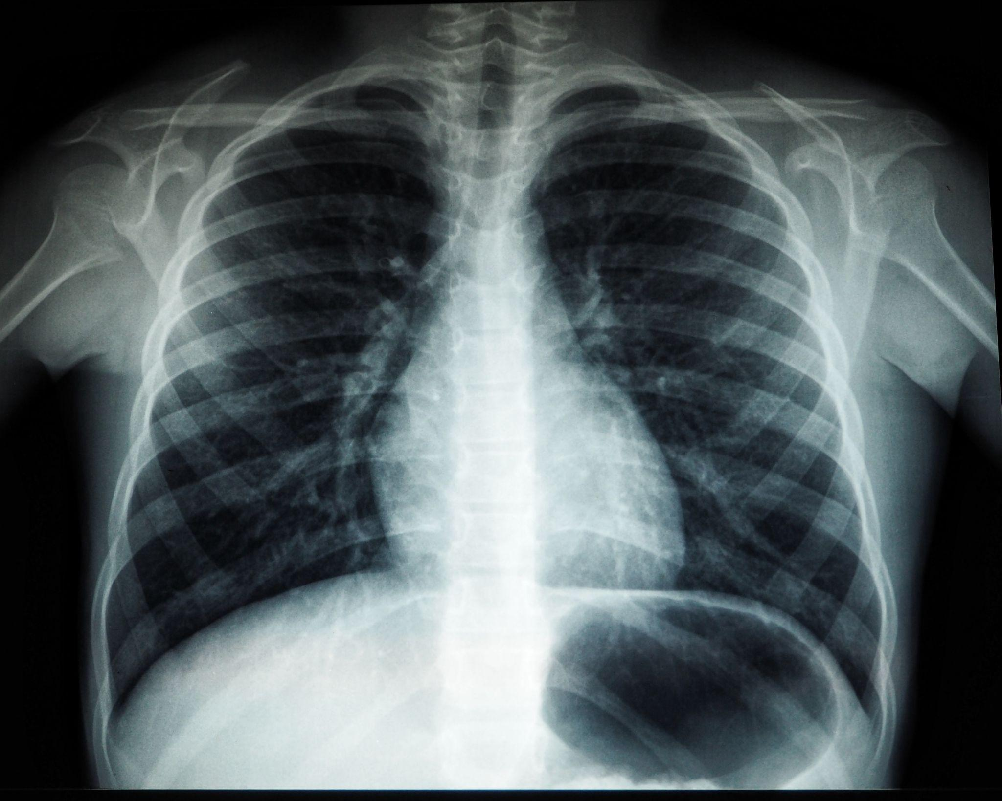

Multitask learning for Pneumonia Detection on Chest X-Ray Images
Guided By:
Prof. Dr. Di Wu
Presented By:
Sushil R Deore
Charan Singh
Vishadh Sawant
University of Colorado Boulder
Master of Science in Data Science
CSCI 5502-072

Slide 2
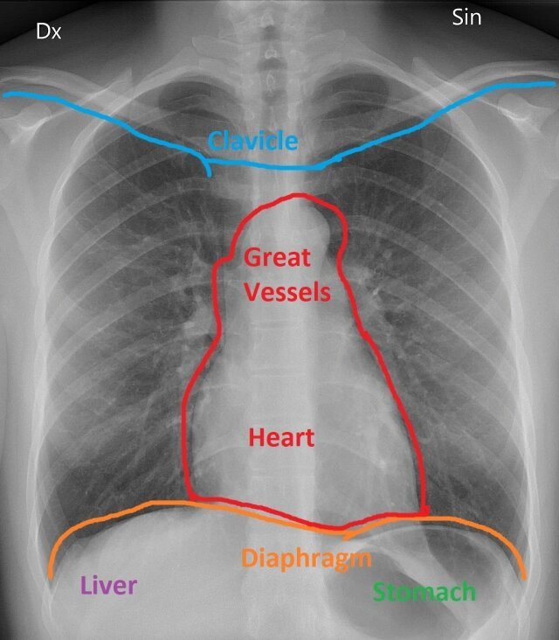
Contents:
Importance of Project
Final Findings
Project impact
Difficulties Faced
Interesting Part
If Start it Over
Lessons from Project
Authors
Figure: Labeled Chest X-Ray

Slide 3
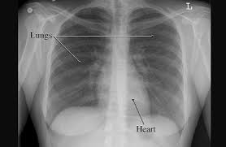
Importance of Project
Pneumonia is difficult to diagnose accurately using traditional methods.
Chest X-ray images are commonly used to diagnose pneumonia, but the interpretation of these images can be subjective and prone to errors.
Multitask learning can be used to improve the accuracy and efficiency of pneumonia detection on chest X-ray images by simultaneously training a model to perform multiple related tasks.
By training the model on tasks, it can learn to identify and localize the areas of the image that contain abnormalities associated with pneumonia more accurately and efficiently.
Multitask learning can help to reduce false positives and false negatives in pneumonia diagnosis, which can improve patient outcomes and reduce healthcare costs.
By reducing the amount of labeled data required for training, multitask learning can also help to overcome limitations in the availability of labeled data for medical image analysis, which can be a significant barrier to progress in this field.
Fig. X-Ray image with label

Slide 4
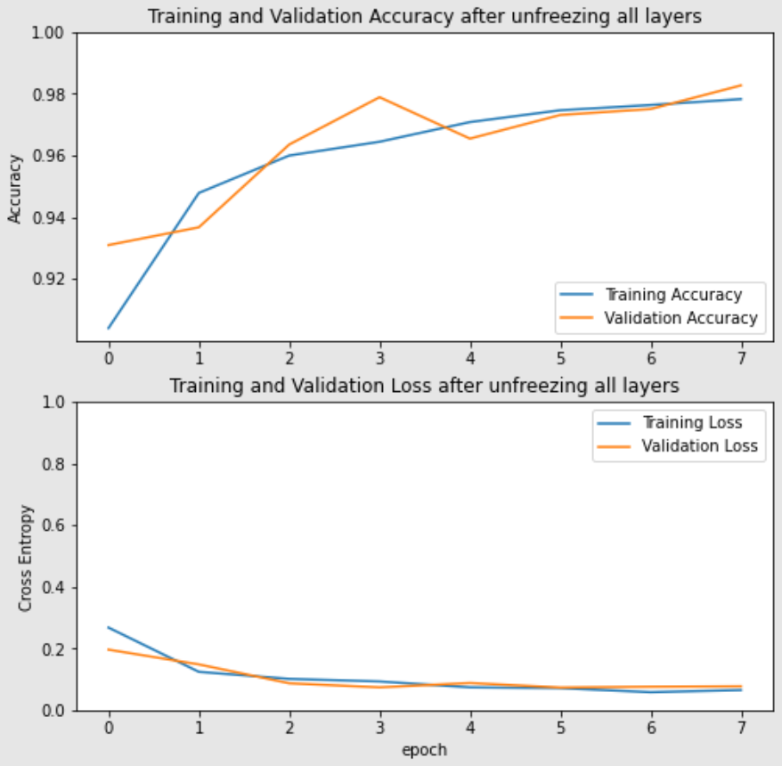
Final Findings
Final Findings are as follow:
We are able to achieve Training Accuracy of Approx. 98% and Validation accuracy of Approx. 97%
Dataset:- Chest X-ray (15000+ images, 3500 are Pneumonia).
Graph shows Training and Validation accuracy after unfreezing all layers.
Method used:- Densenet model (Supervised Learning)
Graph Epoch Vs. Cross Entropy shows performance of a machine learning model during the training process.
The X-axis represents the number of training epochs (or iterations), and the Y-axis represents the cross-entropy loss, which is a measure of how well the model is predicting the correct class labels.
The shape of the epoch vs cross-entropy graph can provide insights into the behavior of the model during training. If the loss decreases slowly but steadily over time, this may indicate that the model is learning gradually and steadily, which can be a good sign for its ability to generalize to new data.
Fig. Image Classification model Evaluation

Slide 5
Project Impact
The project can improve the accuracy and efficiency of pneumonia detection on chest X-ray images.
It can help reduce false positives and false negatives in pneumonia diagnosis, which can improve patient outcomes and reduce healthcare costs.
By reducing the amount of labeled data required for training, the project can help overcome limitations in the availability of labeled data for medical image analysis, which is a significant barrier to progress in this field.
The project can help radiologists and healthcare professionals to diagnose pneumonia more accurately and efficiently, leading to better patient care.
It can also provide a framework for the development of other machine learning models for medical image analysis, which could have broader applications in healthcare and beyond.
Improve
Reduce
Overcome
Help
Provide

Slide 6
Difficulties Faced
Limited availability of labeled data: obtaining a sufficient amount of labeled data for medical image analysis can be challenging, especially for rare diseases like pneumonia.
Interpreting and analyzing X-ray images: Interpreting X-ray images can be subjective, and different radiologists may have different opinions on the presence and severity of pneumonia. Additionally, X-ray images may contain artifacts or other abnormalities that can affect the accuracy of the model's predictions.
Complexity of the machine learning model: Multitask learning requires a complex machine learning model that can perform multiple tasks simultaneously. Developing and optimizing such a model can be challenging, and may require expertise in machine learning, computer vision, and medical imaging.
Integration with existing healthcare systems: Implementing the machine learning model in a clinical setting may require integration with existing healthcare systems, which can be complex and time-consuming.
Ethical considerations: The use of machine learning for medical diagnosis raises ethical considerations, including privacy, fairness, and accountability.
Limited Availability
Interpreting Results
Complexity of Model
Integration with Existing System
Ethical Issues

Slide 7
Interesting Parts
Multitask learning approach: The project uses a multitask learning approach to simultaneously train a machine learning model to perform multiple related tasks, which can improve the accuracy and efficiency of pneumonia detection on chest X-ray images.
Use of medical imaging data: The project involves the use of medical imaging data, which is a challenging and important area of research in machine learning. The project can help to improve the accuracy of medical image analysis and diagnosis, which can have significant implications for patient care.
Potential for broader applications: The project can provide a framework for the development of other machine learning models for medical image analysis, which could have broader applications in healthcare and beyond.
Potential to improve patient outcomes: The project has the potential to improve patient outcomes by improving the accuracy and efficiency of pneumonia diagnosis, which can lead to earlier and more effective treatment.
Addressing a challenging problem: Pneumonia is a challenging disease to diagnose accurately, and traditional methods of diagnosis can be subjective and prone to errors. The project addresses this challenging problem by developing a machine learning model that can improve the accuracy of pneumonia diagnosis on chest X-ray images.

Slide 8
If Start it Over
Process of Starting MTL for Pneumonia Detection on Chest X-Ray Images
Define the scope and objectives of the project
Gather and preprocess data
Develop a machine learning model
Implement multitask learning
Evaluate and refine the model
Validate the model
Integrate the model into clinical practice
Monitor and update the model
Here, We want to update if we start Over, because,
Limitation of labeled data
Image clearity
Class Imbalance

Slide 9

Lessons from Project
Multitask learning can improve the accuracy and efficiency of medical image analysis
Machine learning can address challenging problems in healthcare
Preprocessing is important for medical image analysis
Collaboration with healthcare professionals is crucial
Continuous monitoring and updates are important

Slide 10
Authors
Sushil Ramdas Deore
Charan Singh
Vishadh Sawant
Worked on Multi-Task learning setup
Worked on Supervised learning setup
Worked on Unsupervised learning setup

Slide 11
Thank you !!!!

